Slide 1
Dijkstra Part II
Priority Queue Implementation

Slide 2
What we know
Goal of Dijkstra’s Algorithm
How graphs are stored internally
Min-heap data structure

Slide 3
What is a priority queue?
Just like a regular queue or stack data structure, but...
Each element has a “priority” associated with it
What has the highest priority in Dijkstra’s algorithm?

Slide 4
Priority Queue: Dijkstra
Min-Heap structure organized by edge weight
Each (edge) node also contains information about the vertex it is going to
Added field for each node in min-heap

Slide 5
Improved Implementation
If the graph is represented internally with an adjacency list our Dijkstra’s implementation can be improved:
Original - 𝐎 ( 𝐕 ⋅ log(𝐕 ) )
New - O ( E ⋅ log(𝐕 ) )
(Where V = Vertices, E = Edges)

Slide 6
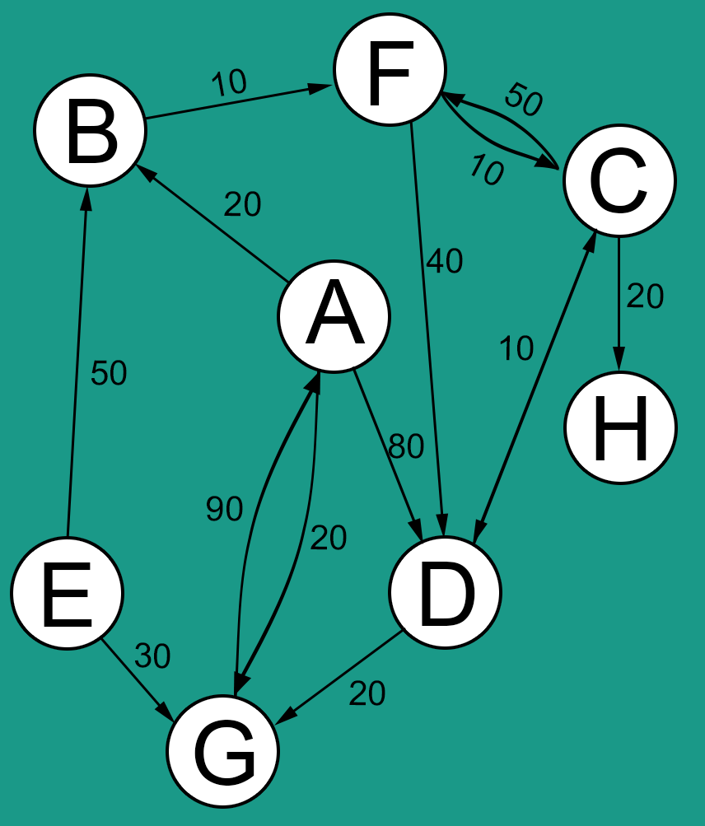
Example with Code

Slide 7
Traversing
Tree and Graph Traversal Methods

Slide 8
What We Know
Breadth First
Depth First
Graph vs. Tree

Slide 9
What is a graph traversal?
Technical Definition:
In computer science, graph traversal (also known as graph search) refers to the process of visiting (checking and/or updating) each vertex in a graph. Such traversals are classified by the order in which the vertices are visited.
Human Definition:
The process of visiting each node exactly once, in some order.

Slide 10
Binary Tree Depth-First Traversals
Preorder: <root> <left> <right>
Inorder: <left> <root> <right>
Postorder: <left> <right> <root>

Slide 11
Preorder (Java)
public void Preorder(Node root) { if (root == null) { return; } else { System.out.println(root.data); Preorder(root.left); Preorder(root.right); } }

Slide 12
Postorder (Java)
public void Postorder(Node root) { if (root == null) { return; } else { Postorder(root.left); Postorder(root.right); System.out.println(root.data); } }

Slide 13
Inorder (Java)
public void Inorder(Node root) { if (root == null) { return; } else { Inorder(root.left); System.out.println(root.data); Inorder(root.right); } }

Slide 14
Breadth-First Traversal
Also known as level traversal (for trees).
Visit and mark each node at each level, then continue.

Slide 15
Level-Order (Java)
void printLevelOrder() { int h = height(root); int i; for (i = 0; i < h; i++) printGivenLevel(root, i); }
void printGivenLevel(Node root, int level) { if (root == null) return; if (level == 0) System.out.print(root.data + " "); else if (level > 0) { printGivenLevel(root.left, level - 1); printGivenLevel(root.right, level - 1); } }

Slide 16
Graph Traversals
Same principles, but:
Often a Queue is used to keep track of vertices to visit next.
Can be either a Priority Queue or any other type of Queue.
An array or other similar structure is used to keep track of the vertices already visited.
Why? Graphs can have cycles, whereas trees cannot.

Slide 17
Breadth First (Pseudoish-code)
queue.add(startingNode); // Add starting node while (queue.empty() == false) { // While things to visit Node temp = queue.poll(); // Get first thing in q visited.add(temp); // Add it to visited list System.out.print(temp.value); // Level 0 for (Node neighbor : temp.edges) // For each edge if (!visited.contains(neighbor)) // If not visited queue.add(neighbor); // Add to q }

Slide 18
Depth First Search
How would we modify our existing DFS algorithms to operate on a graph?
Keep track of a queue.
Keep track of vertices visited.
If the vertex you are looking at is already visited, move on.

